Slide 1
Serious Game Development for Dementia Care Using Preferred Music, Music Therapy
Loftie Fourie
31607500

Slide 2
Problem Statement
Developing a Music Therapy-Based Serious Game for Dementia Care and Incorporating preferred music
Aim
Advantages
Improving the Quality of life for patients living with Dementia
Long-term Use
Enhanced Engagement
Memory Stimulation
Other advantages of preferred music

Slide 3
Methodology
Using a design science methodology to develop a serious game, a preferred music script as well as a controller for the game.
The Game is developed in Godot with simplicity and playability in mind.
The preferred music script will be used to analyze and dissect mp3 files that will be used by the game.
The controller will ensure physical and cognitive engagement as well as improving ease of use

Slide 4
Concepts
Serious Games
A game with a primary purpose other than entertainment, usually for education, training, or other goals
Music Therapy
The use of music to improve physical, emotional and mental well-being
Preferred Music
Music that is preferred or favoured by the patient

Slide 5
Artefact
Tune Therapy
A game written in Godot to use the drums or claps in music to play the game. Incorporating aimed motivational reassurance to encourage players
Preferred Music Script
Using Python to get the percussive spectrograms of mp3 files and using a function to determine the appropriate frequency range where the desired number of beats are received for the game.
Controller
Using Raspberry Pis to develop a drum to be used for the game. These controllers are wireless to remove any hazards and can easily replicated.

Slide 6
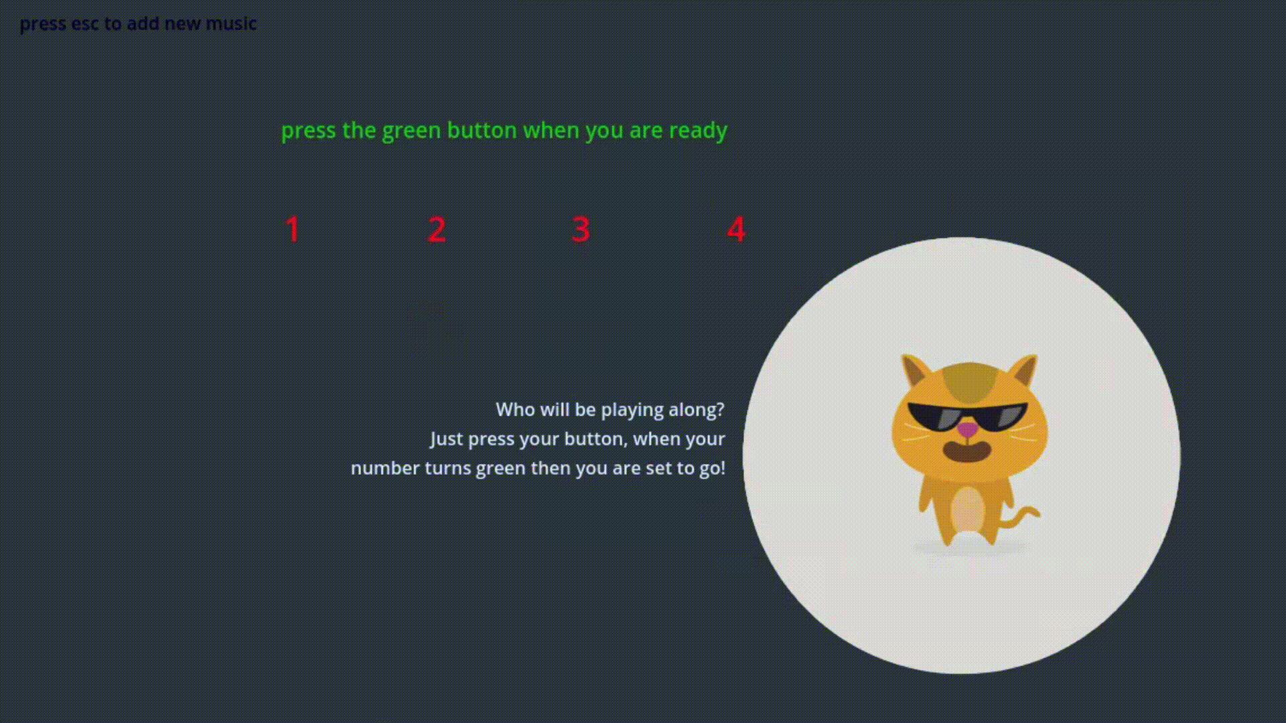
Demonstration

Slide 7
Results
Docter Susan Coetzer, Geriatrician and Vice President of the South African Geriatrics Society
Effectiveness 10
Usability 8
Engagement 9
Integration of Music Therapy 10
Accessibility 7
Implementation 9
Impact on emotional well-being 9
Integration with care plans 10
Adherence and Long-Term Use 9
Customization 10
Ethical considerations 9

Slide 8
Conclusion
Patients’ benefits are enhanced through the integration of preferred music and long-term usability is promoted. The development of a user-friendly controller further ensures simplicity and understandability, thus increasing the accessibility and feasibility of this as an intervention for dementia patients.

Slide 9
Loading…

